Slide 1

TECHNOXIAN ROBO RACE
By
Gokul Sai R (1GA17EC041)
Gowrav S (1GA17EC042)

Slide 2
INTRODUCTION
This competition was based on showcasing the extent of designing the Bot in completing the hurdles given out to the participants
The bot was designed based on the dimensions specified by the event which is 25Cm height and 35*25Cm its length and breadth, the bot designed should be minimised within the given threshold
All the motor should be given only with 12v and not more than that so we used power distribution board in order to achieve this criteria

Slide 3
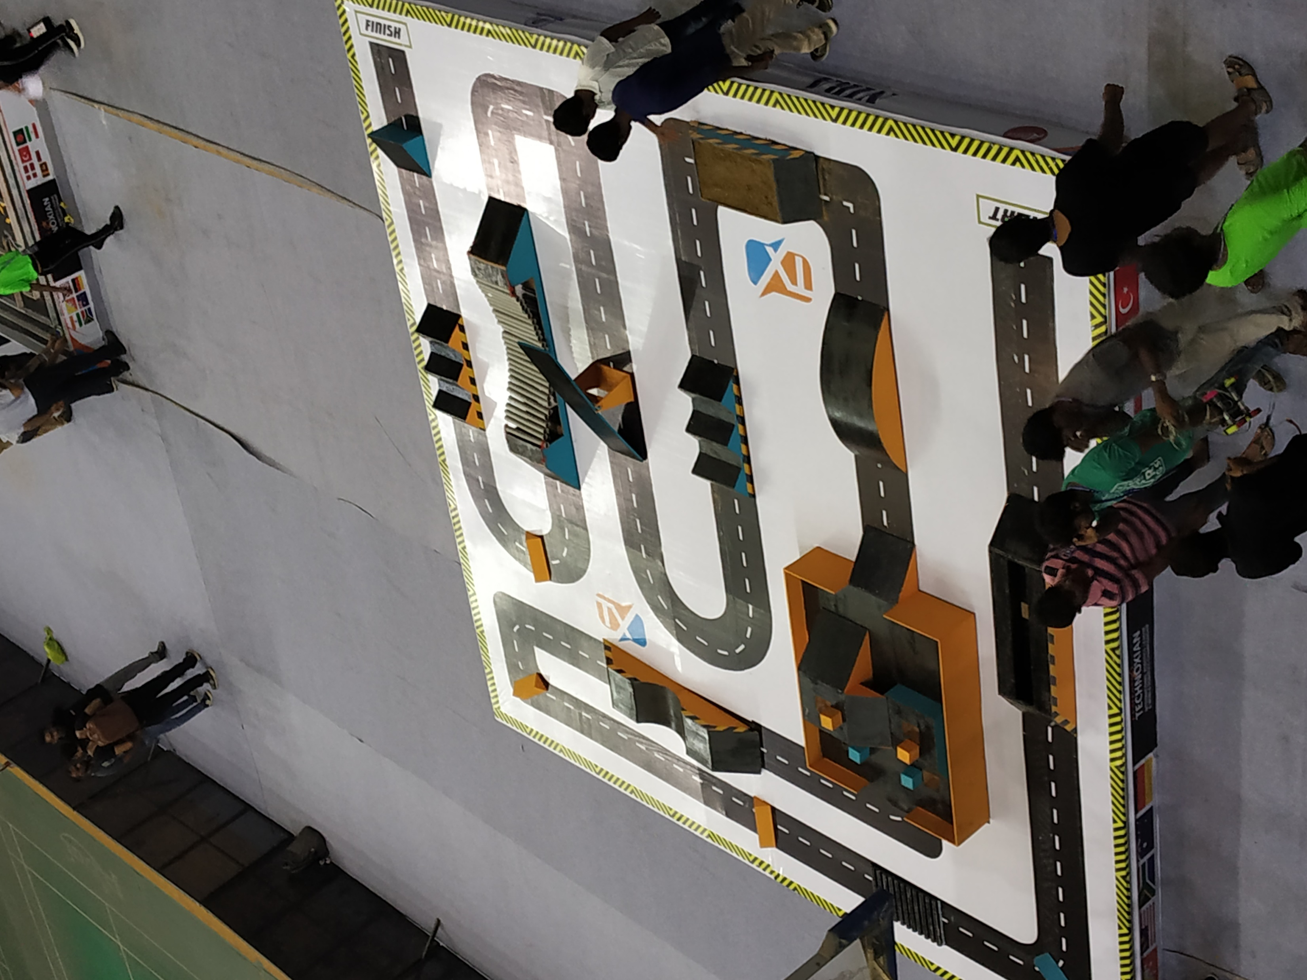
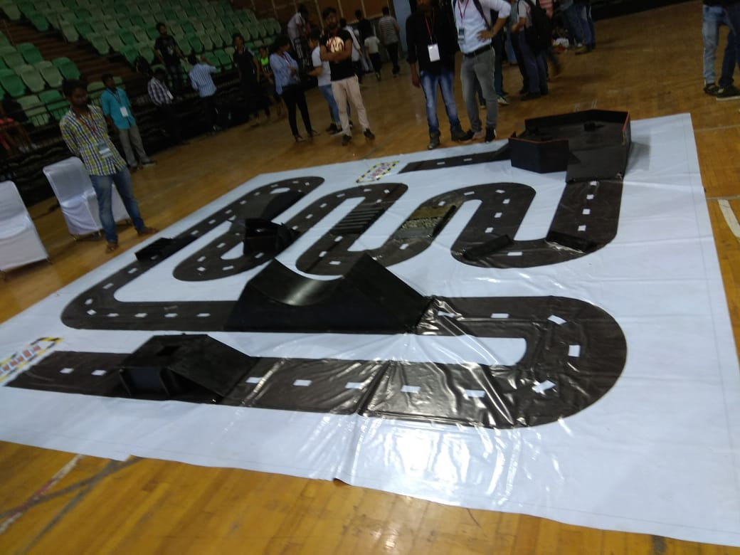
TRACK
1ST ROUND
2ND ROUND

Slide 4
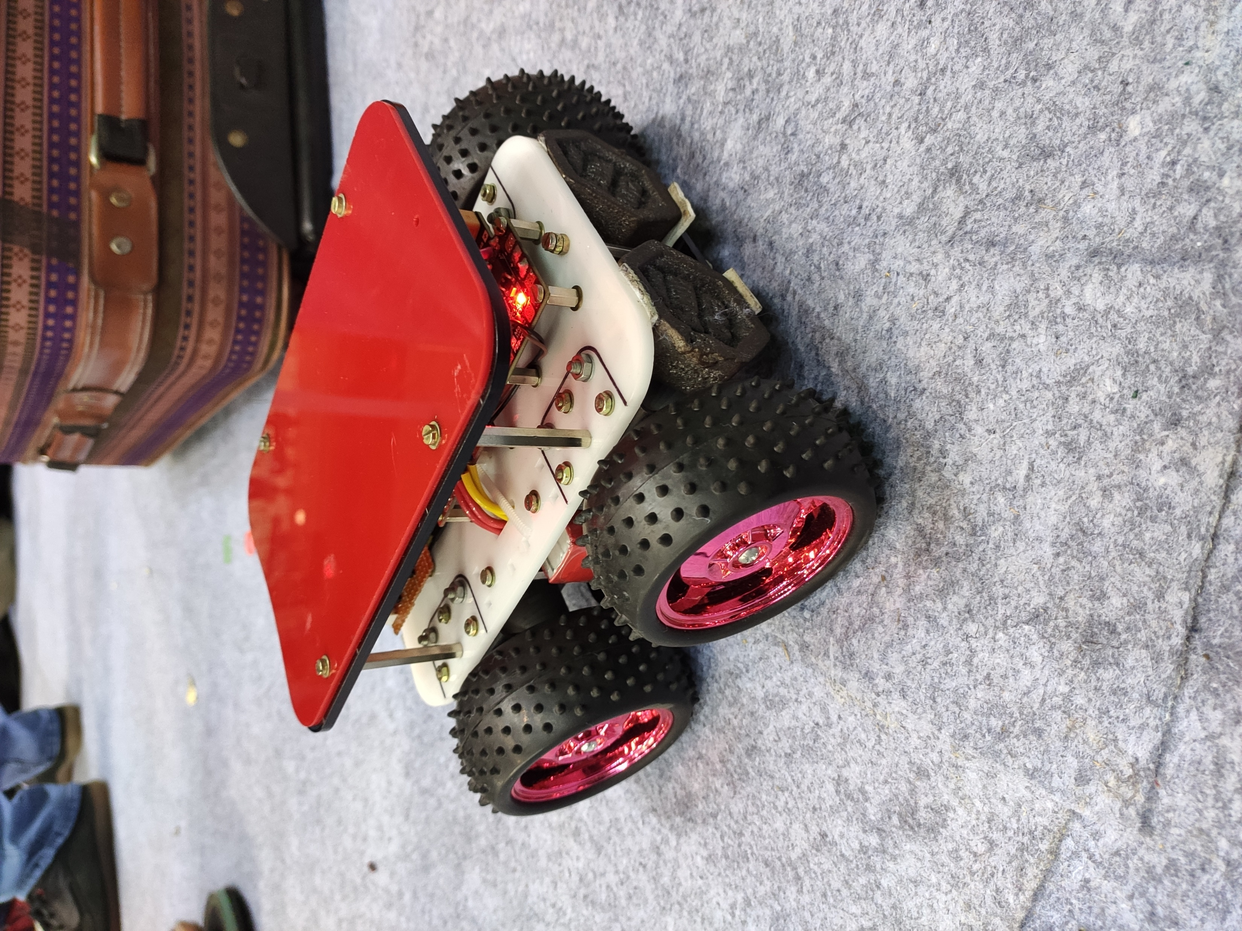
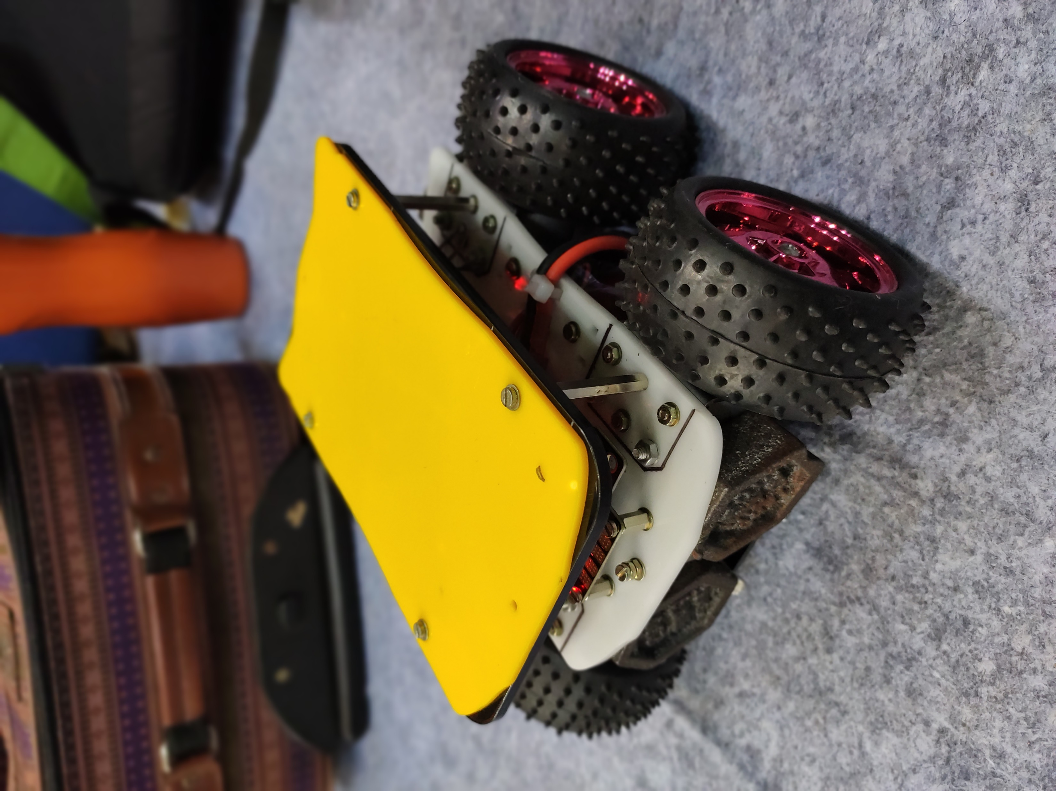
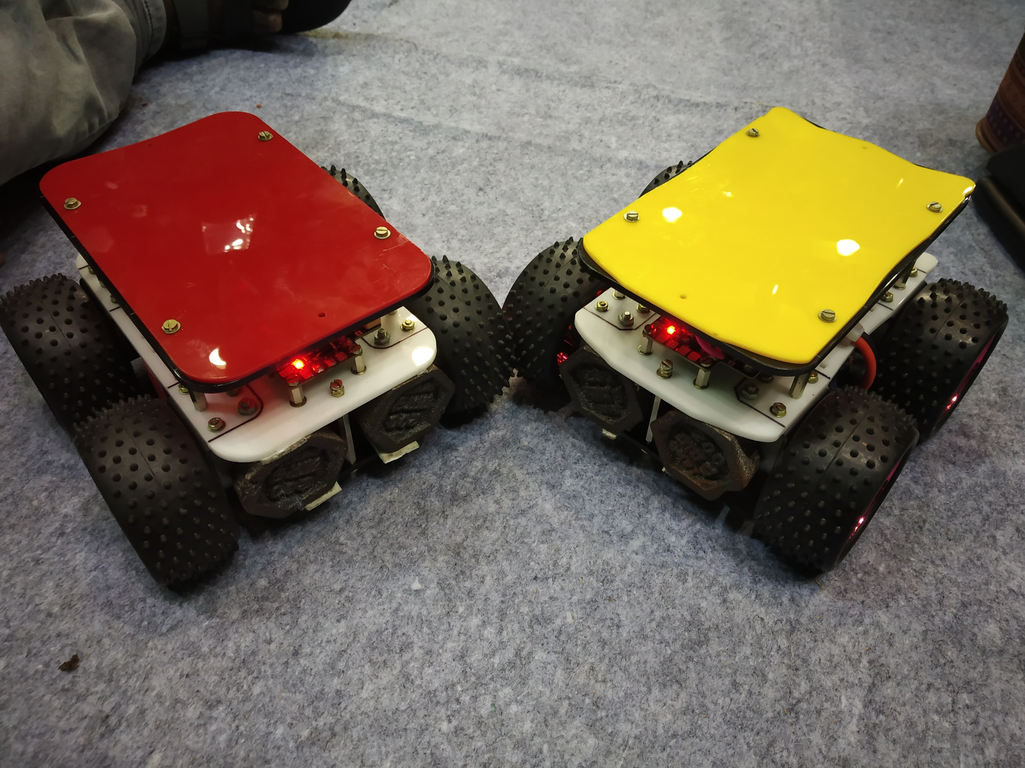
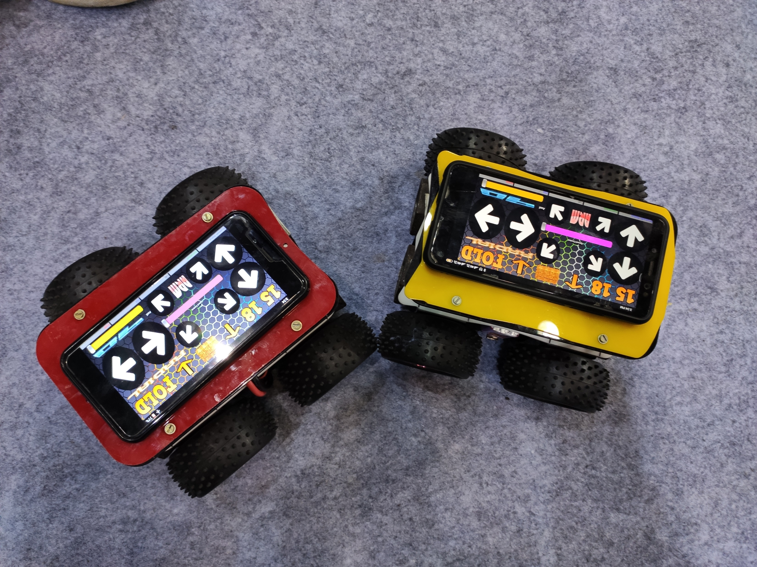
BOT

Slide 5
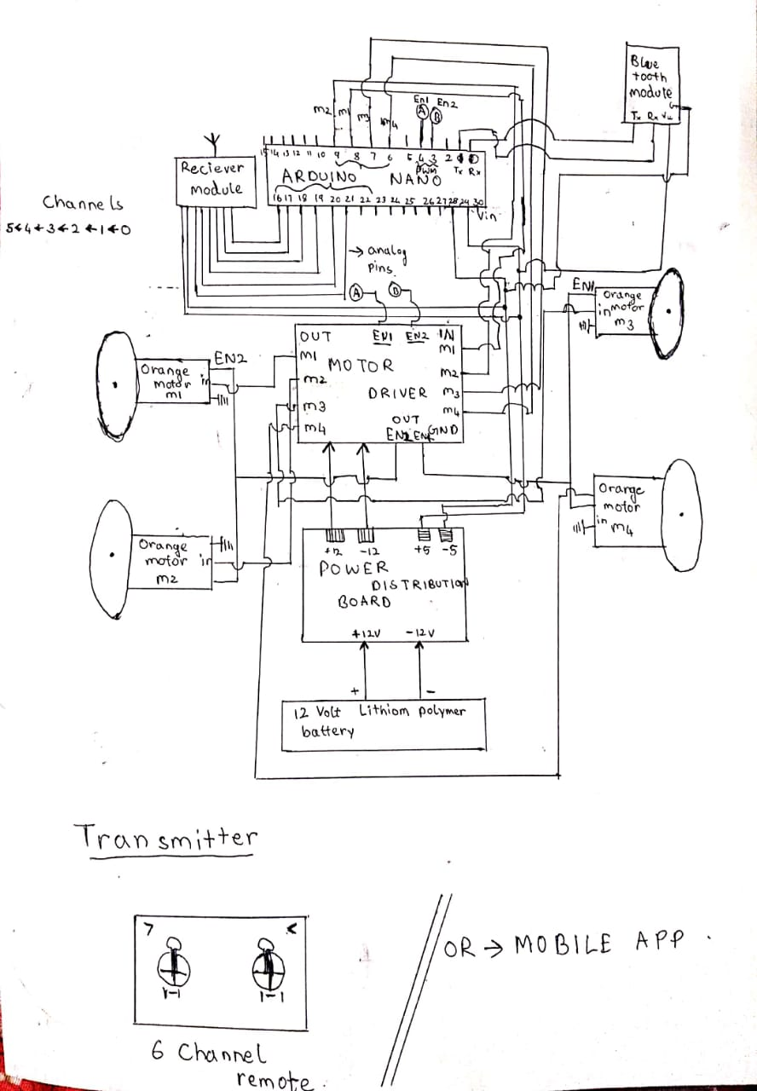
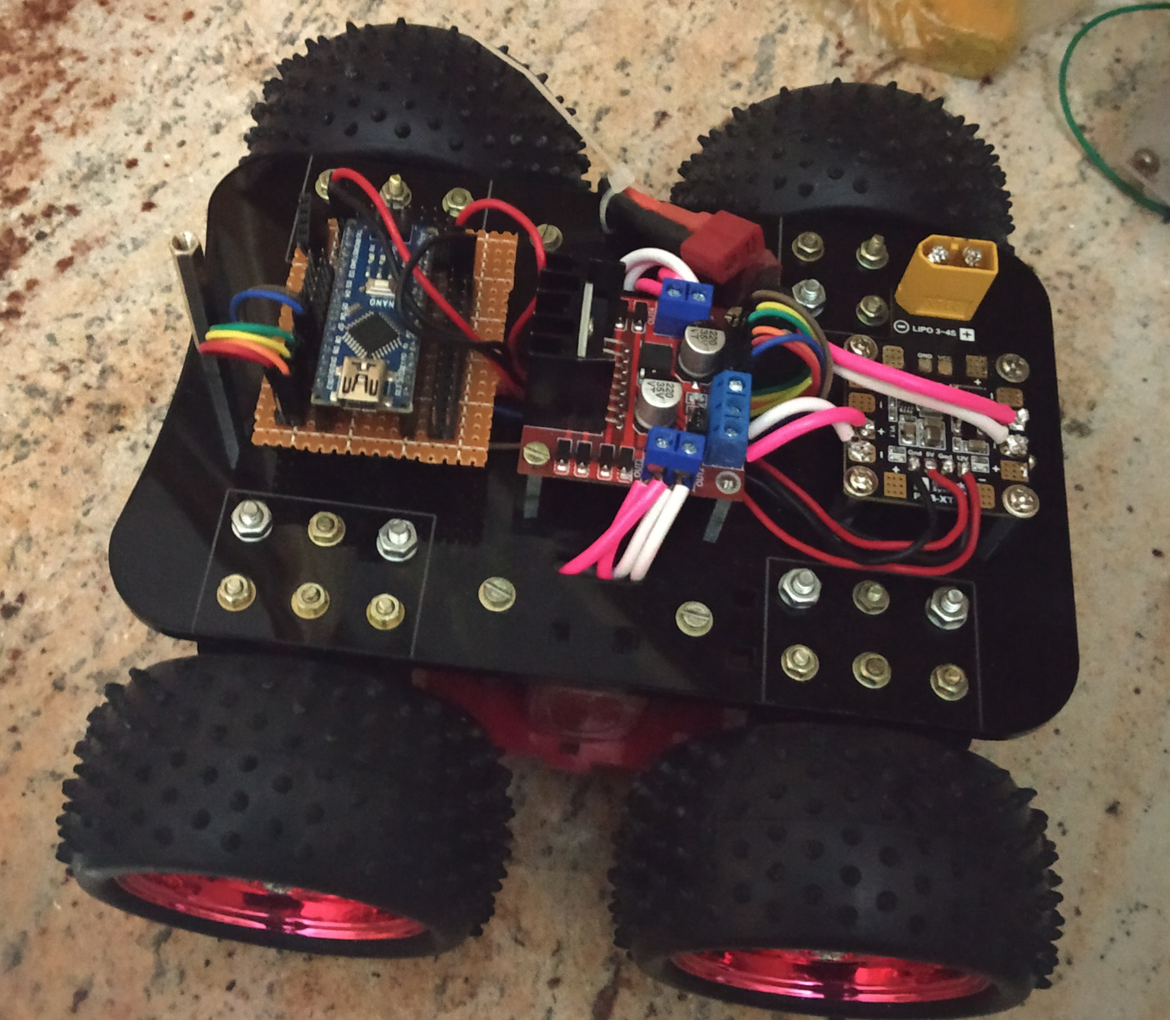
CIRCUIT DIAGRAM

Slide 6
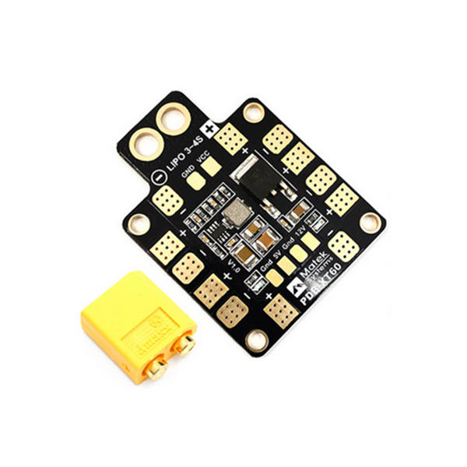
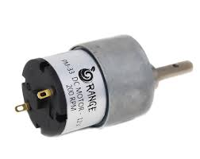
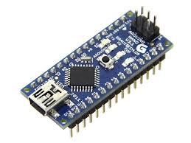
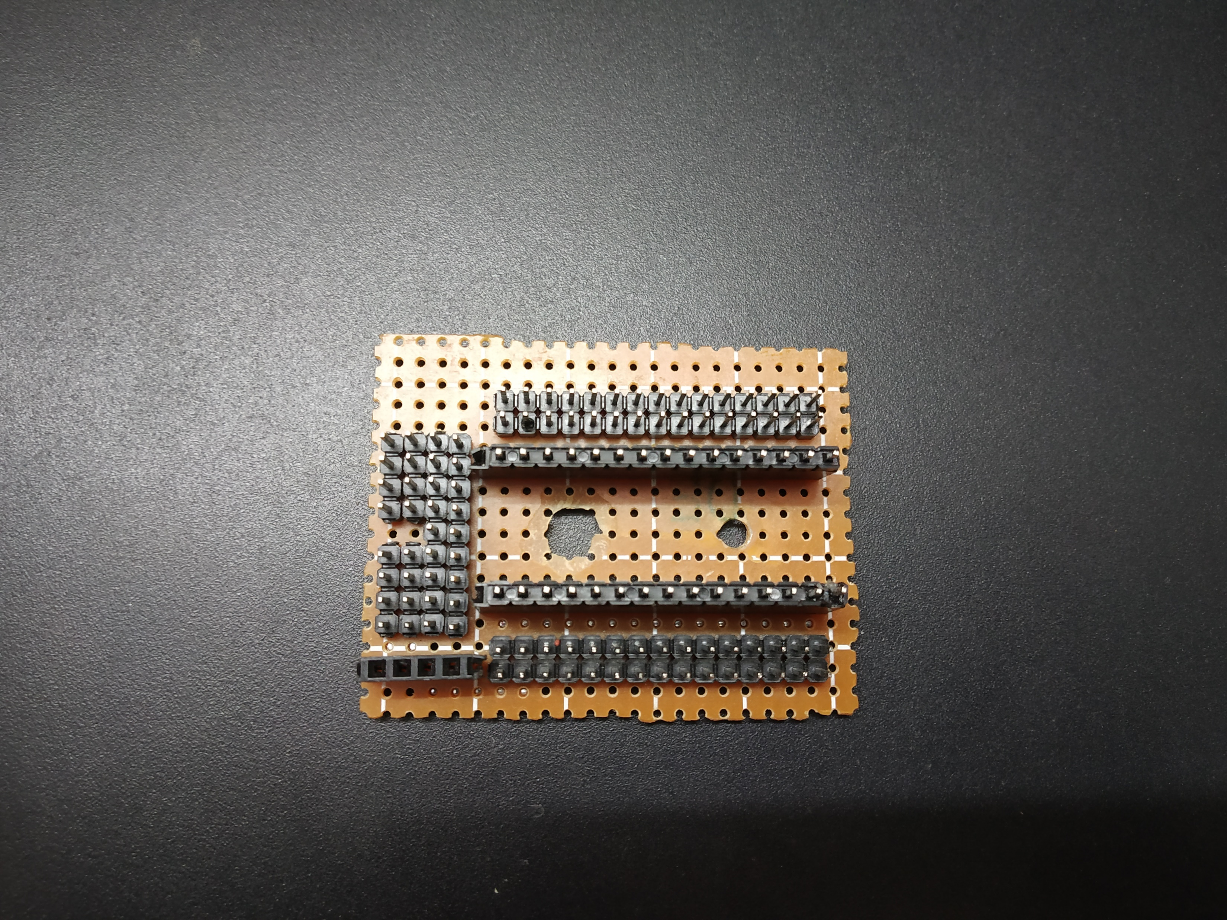
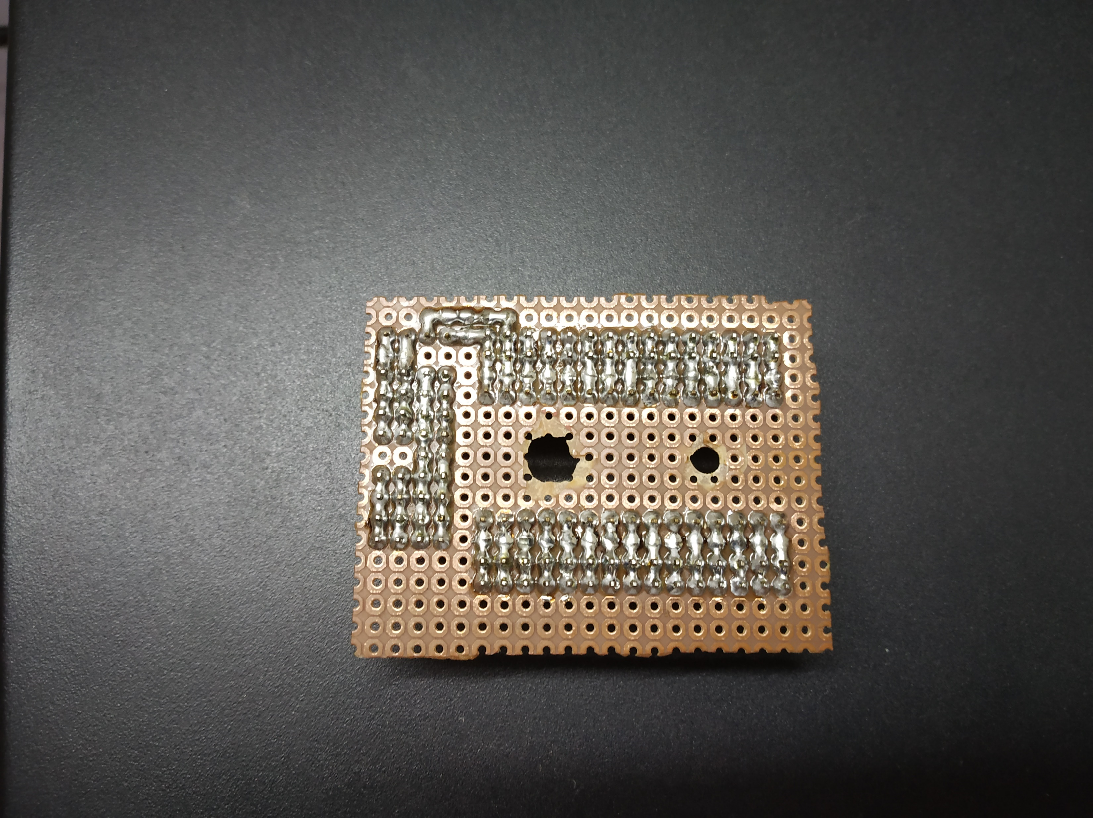
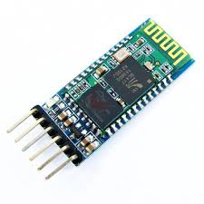
MAIN COMPONENTS
Power Distribution Board
Orange dc motors
Arduino nano
Coustmized circuit
Bluetooth module

Slide 7
METHODS OF CONTOLLING THE BOT
WE HAD MADE 2 WAYS TO CONTROL THIS BOT :
THROUGH ANDROID APP : THIS APP IS BUILT BY US USING MIT APP INVENTOR THROUGH BLUETOOTH COMUNICATION.
THROUGH REMOTE CONTROLLER

Slide 8
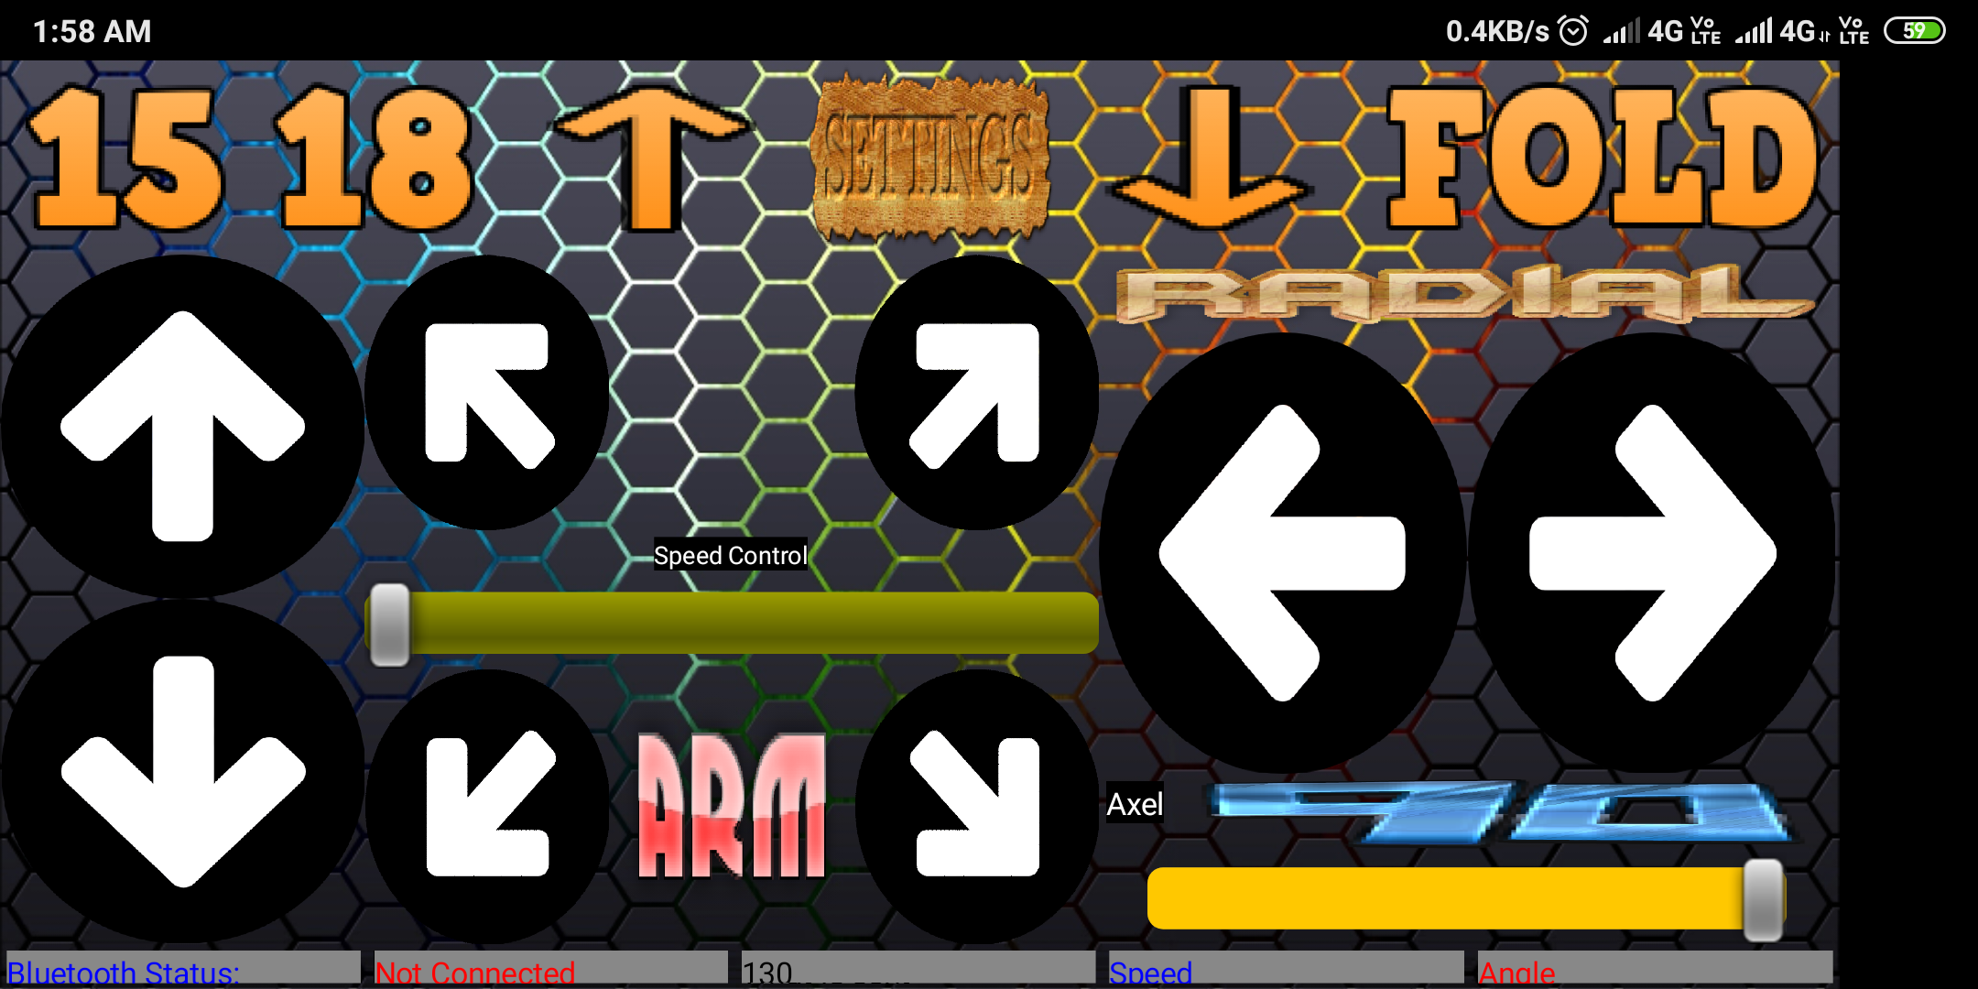
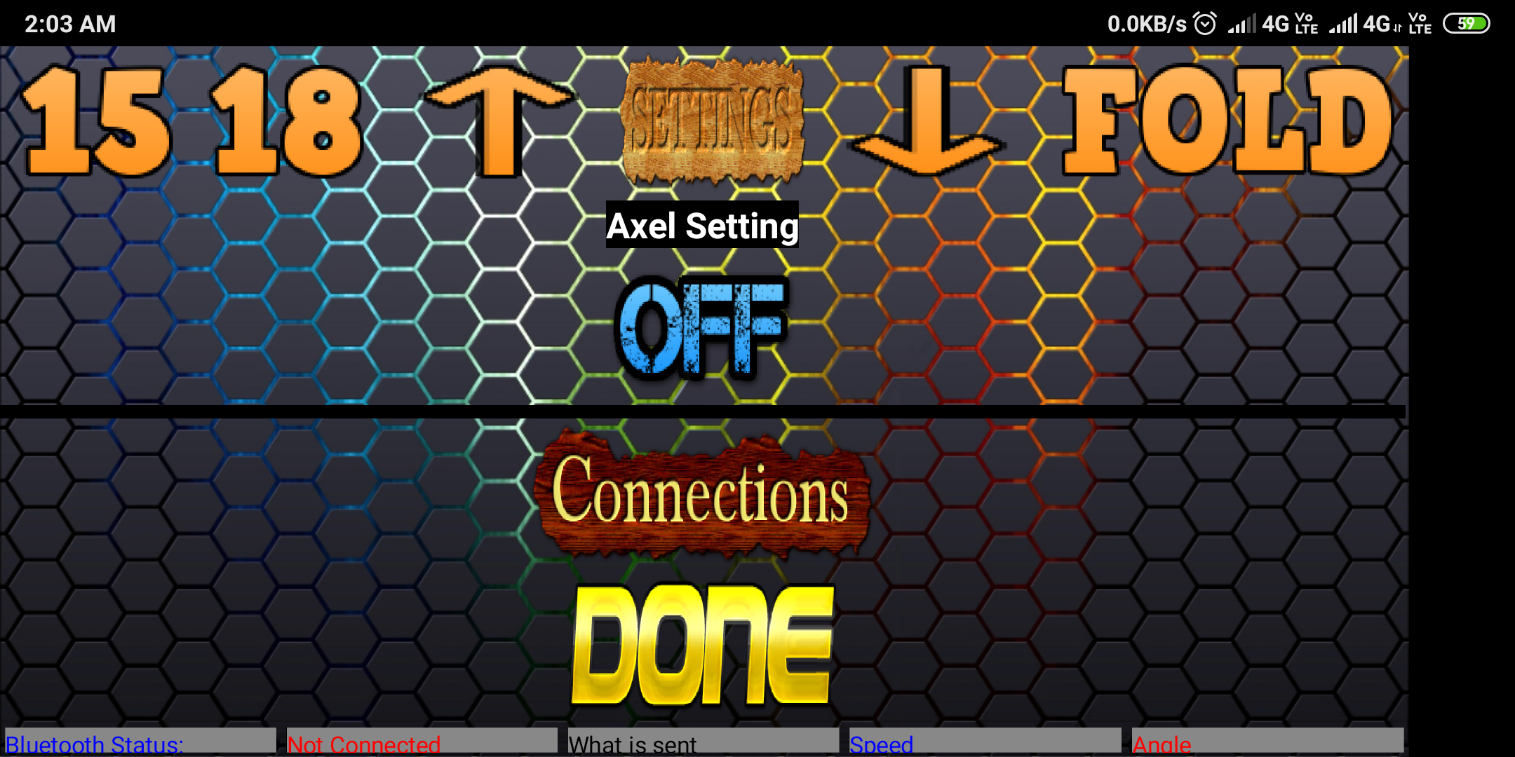
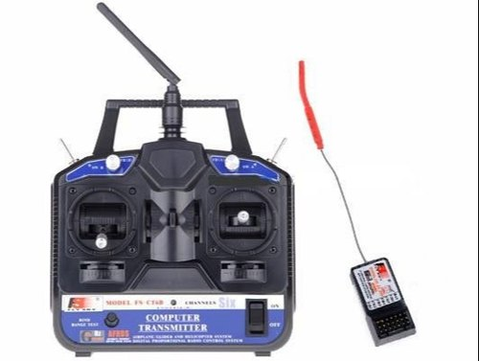
RCCONTROL APP
REMOTE CONTROLLER

Slide 9
PROGRAMMING DESIGN OVERVIEW
Since this event was based on hurdles
We decided to allocate 3 modes being
1.Normal mode : this mode was to look into the normal function of the bot wherein forward, backward and also radial and axial turns were under this mode of operation.
2.Differential mode : this mode was to look into sharp and precise turnings sometimes the bot finds difficulty at the sharp turnings at such cases this mode is used especially for turning at a particular angle .
3.Stop mode : this mode is operated in order hault the bot as and when required.

Slide 10
Acknowledgement
We gowrav and gokul thank hod sir and respected principal AND ALL THE TEACHERS to support us in doing the project and upon execution of this project we were able to learn more and more of what can be improved to our project . We thank you again sir

